Slide 1


Slide 2
Format of Proverbs
Tsonga proverb
Direct translation
Actual meaning

Slide 3
Disclaimer
There will be a lot of cultural bias stemming from the age and societal situation where these phrases were coined.

Slide 4
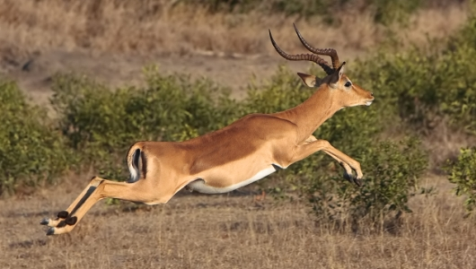
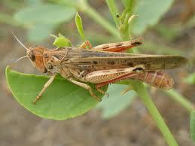
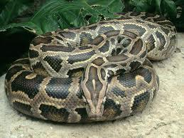
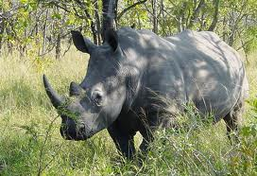
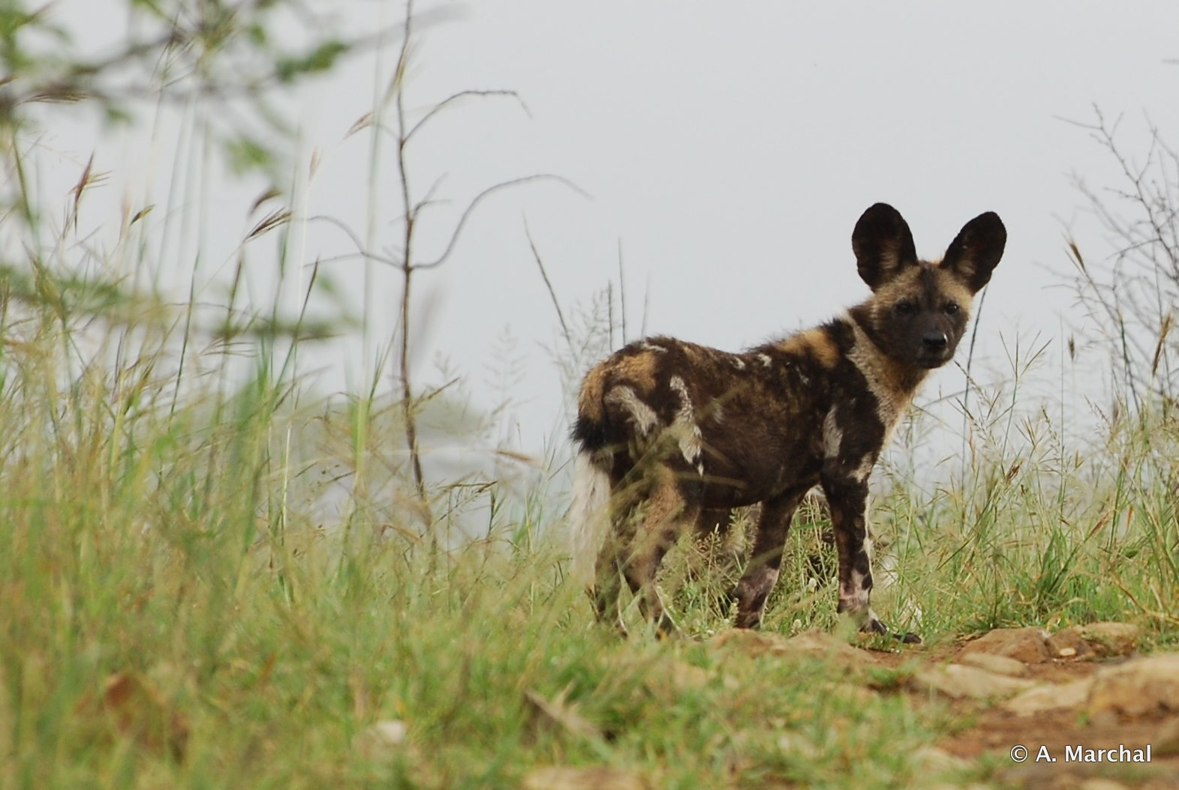
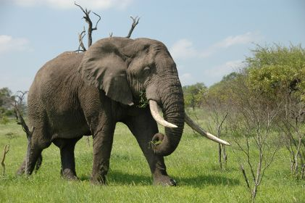
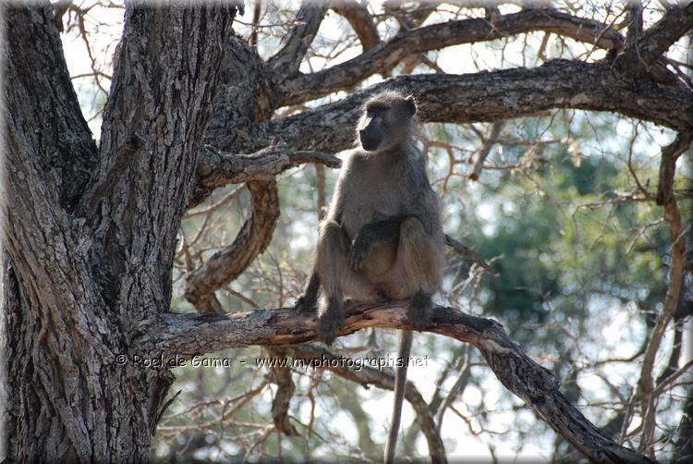
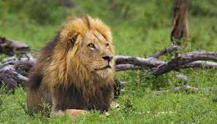
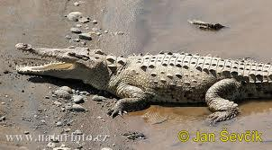
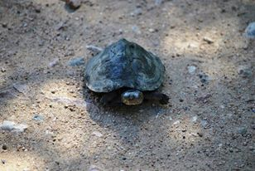
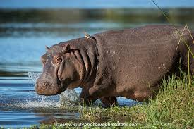
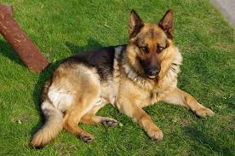
Animals
Mhala
Njiya
Nyoka
Mhelembe
Mhisi
Ndlopfu
Mfene
Nghala
Ngwenya
Xibodze
Mpfuvu
Mbyana

Slide 5
Mhala

Slide 6
Proverb
Ku tlula ka mhala ku letela n’wana wa le ndzeni
Translation
The jumping of the impala instructs the inner child
Meaning
Children take after their parents

Slide 7
Nyoka

Slide 8
Proverb
N’wana wa nyoka i nyoka
Translation
The child of a snake, is a snake
Meaning
Children take after their parents

Slide 9
Proverb
Nyoka yo yi vona a yi lumi
Translation
A snake that you see does not bite
Meaning
Forewarned is forearmed

Slide 10
Proverb
U nga dlayi nyoka u ndzuluta hiku ta micele ta ku vona
Translation
Do not kill a snake and wind it because those in the holes can see you
Meaning
Whenever you do something, you must think of the consequences

Slide 11
Ndlopfu

Slide 12
Proverb
Ndlopfu a yi fi hi rivambu rin’we
Translation
An elephant does not die of one rib
Meaning
A strong person does not give up after one try

Slide 13
Proverb
Ndlopfu i xakwa
Translation
An elephant is its trunk
Meaning
People are because of the support they receive

Slide 14
Proverb
Risokoti ri dlele ndlopfu
Translation
An ant killed an elephant
Meaning
Never underestimate anybody

Slide 15
Proverb
I ndlopfu ya hina hinkweru
Translation
This elephant belongs to all of us
Meaning
It is all our problem to fix

Slide 16
Nghala

Slide 17
Proverb
Nghala yi etlela ni meno ya yona
Translation
A lion sleeps with its teeth
Meaning
You snooze, you lose

Slide 18
Proverb
Emahlweni ka nghala famba na xisana
Translation
In front of a lion take a fire
Meaning
Be prepared when you approach a difficult target

Slide 19
Proverb
Nghala yi vomba exihlahleni
Translation
A lion roars in the bush
Meaning
A person is more confident in his/her territory

Slide 20
Xibodze

Slide 21
Proverb
Xibodze xa munghana a xi chayeriwi noti
Translation
Do not whistle to a friend’s tortoise
Meaning
Look after your own

Slide 22
Mbyana

Slide 23
Proverb
Nyuku wa mbyana wu helela voyeni
Translation
The sweat of a dog finishes in its fur
Meaning
To work for no reward

Slide 24
Njiya

Slide 25
Proverb
Vana va munhu va tsemelana nhloko ya njiya
Translation
Siblings cut the head of a locust for each other
Meaning
Sharing is caring

Slide 26
Proverb
Njiya a yi fani na muroho
Translation
A locust is not the same as a vegetable
Meaning
A little is better than nothing

Slide 27
Mhelembe

Slide 28
Proverb
Loko u tsundzuka mhelembe, khandziya murhi
Translation
When you remember a rhino, climb a tree
Meaning
Tackle a problem as soon as you realise it

Slide 29
Mhisi

Slide 30
Proverb
Mhisi yi tlakule tshuri
Translation
A wolf is carrying a tshuri
Meaning
Used to denote poverty

Slide 31
Mfenhe

Slide 32
Proverb
Ku banana hi rhambu ra mfenhe
Translation
To hit each other with the bone of a baboon
Meaning
To help each other

Slide 33
Ngwenya

Slide 34
Proverb
U nga teki sava u ba ngwenya
Translation
Don’t take sand and hit a crocodile
Meaning
Don’t start what you won’t finish

Slide 35
Proverb
Matimba ya ngwenya i mati
Translation
The power of a crocodile is the water
Meaning
People are strong because of others

Slide 36
Proverb
Ku ba mati tingwenya ti etlela
Translation
To beat the water and have the crocodiles sleep
Meaning
To give a bribe

Slide 37
Mpfuvu

Slide 38
Proverb
Ndzi nge dyeriwi hi timpfuvu ndzi nga rimangi nhlalukweni
Translation
I will never allow hippos to eat my produce when I did not even plough by the marshes
Meaning
Said to defend one’s properties or rights

Slide 39
Recap
Mhala
Njiya
Nyoka
Mhelembe
Mhisi
Ndlopfu
Mfene
Nghala
Ngwenya
Xibodze
Mpfuvu
Mbyana

Slide 40
Further Entertainment
https://www.facebook.com/madyondza/posts/483694258321709I
http://en.wikipedia.org/wiki/Tsonga_language
http://www.krugerpark.co.za/krugerpark-times-2-1-animals-name-18978.html
Book: Vutlhari bya Vatsonga, Sasavona Books

Slide 41
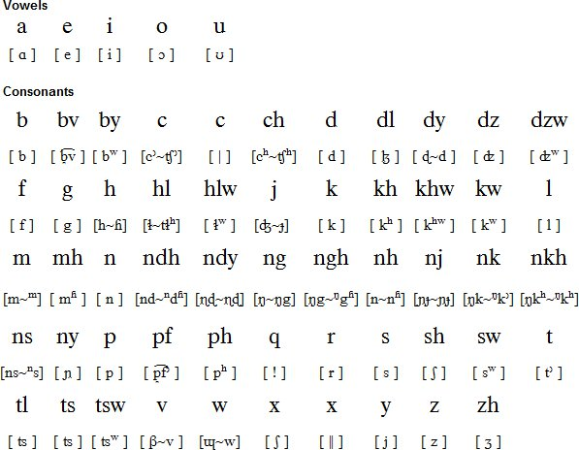
Appendix: Phonetics

